Slide 1
Phonics and Reading Parent Workshop
Laura Strong – Reading and Phonics Lead
Ashley Hill Multi-Academy Trust

Slide 2
Contents
What is phonics?
Set 1 and blending skills
Set 2 and 3
Read Write Inc terminology
Developing fluency and the power of reading at home
Year 1 phonics screening check
Questions

Slide 3
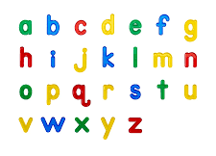

What is phonics?
Phonics is learning the sounds that letters make.
Phonics helps children learn to read and write by teaching them to:
Recognise sounds (phonemes) in spoken words
Match sounds to letters or groups of letters (graphemes)
Blend sounds together to read new words
  c–a–t → cat
Segment words into sounds to help with spelling
  dog → d–o–g
Why is phonics important?
Builds strong early reading skills
Helps children “decode” unfamiliar words
Supports accurate spelling
Develops confidence and fluency
Provides the foundations for comprehension and lifelong reading
In short:
Phonics gives children the tools to crack the code of reading!
At Ashley Hill Multi Academy Trust, our phonics scheme is Read, Write, Inc.

Slide 4
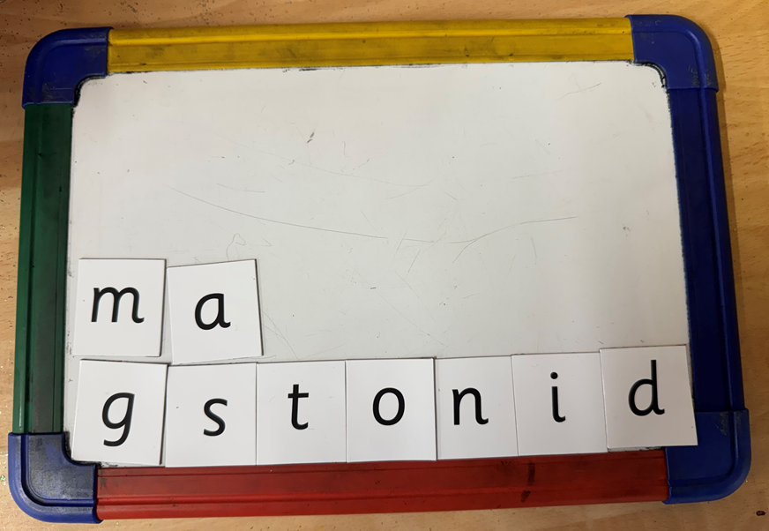
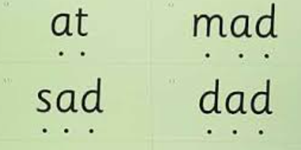
Set 1 and Blending
When children begin their reading journey, they start by learning the Set 1 sounds and how to blend.
At this stage, pupils learn to recognise, read and write the individual sounds. They also practise oral blending, where the teacher says the separate sounds in a word and the children blend them together using listening skills.
Once children are confident with oral blending, they progress to reading whole words. This is a more challenging step, as they must blend the sounds using their own voice, rather than the teacher’s, to read the word accurately.

Slide 5
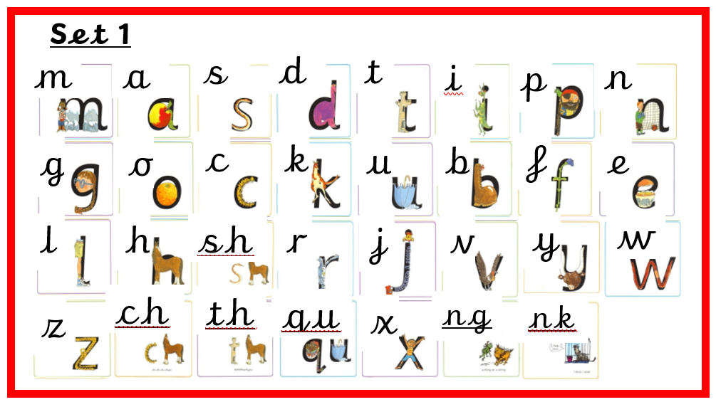
Set 1 and Blending
Set 1 sounds are introduced in a specific sequence to enable children to read as many words as possible from the very beginning. Pure sounds (‘ssss’ rather than ‘suh’).
Read, Write, Inc uses mnemonics to help children retain sounds. A mnemonic is a simple phrase, picture, or saying that helps children remember something more easily.
Once all single-letter sounds have been taught, children are introduced to “special friends”. These are sounds made up of two or more letters that represent one sound.

Slide 6
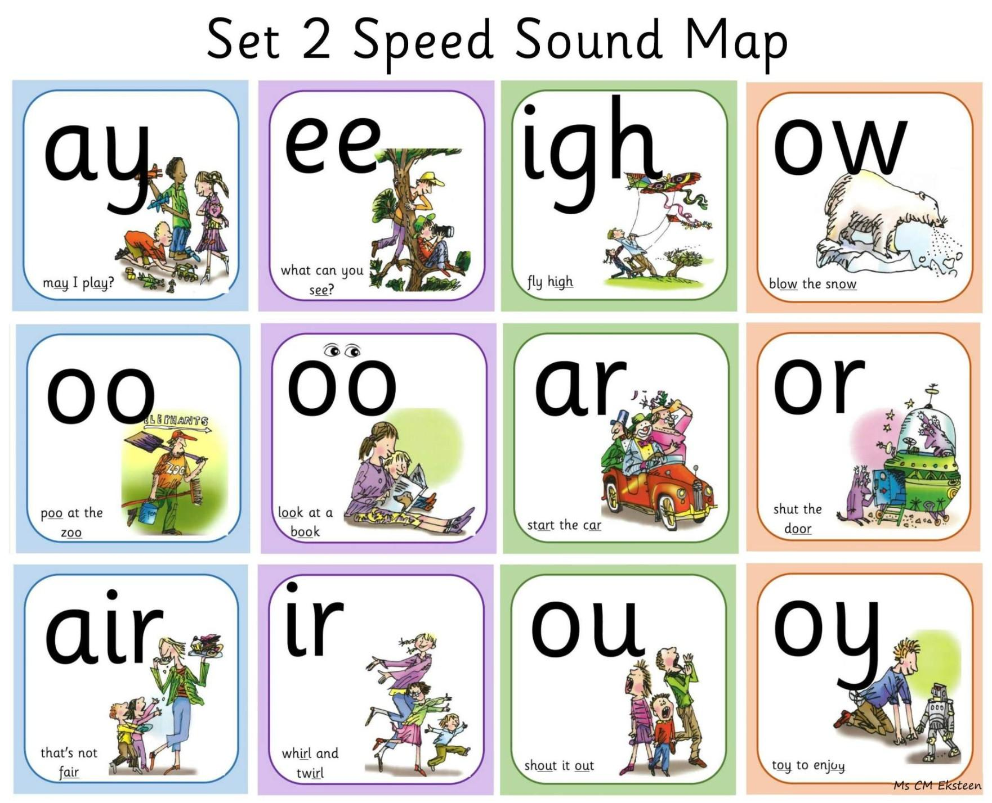
Set 2 and Set 3
Once children have securely mastered the Set 1 sounds and are confident with blending, they move on to learning the Set 2 and then Set 3 sounds.
Set 2 sounds include the remaining common sounds used in spoken English. After learning these, children are able to phonetically attempt to spell any word in the English language.
To support spelling, children are taught to “pinch” the sounds in a word on their fingers, identifying each sound in sequence before writing it.

Slide 7
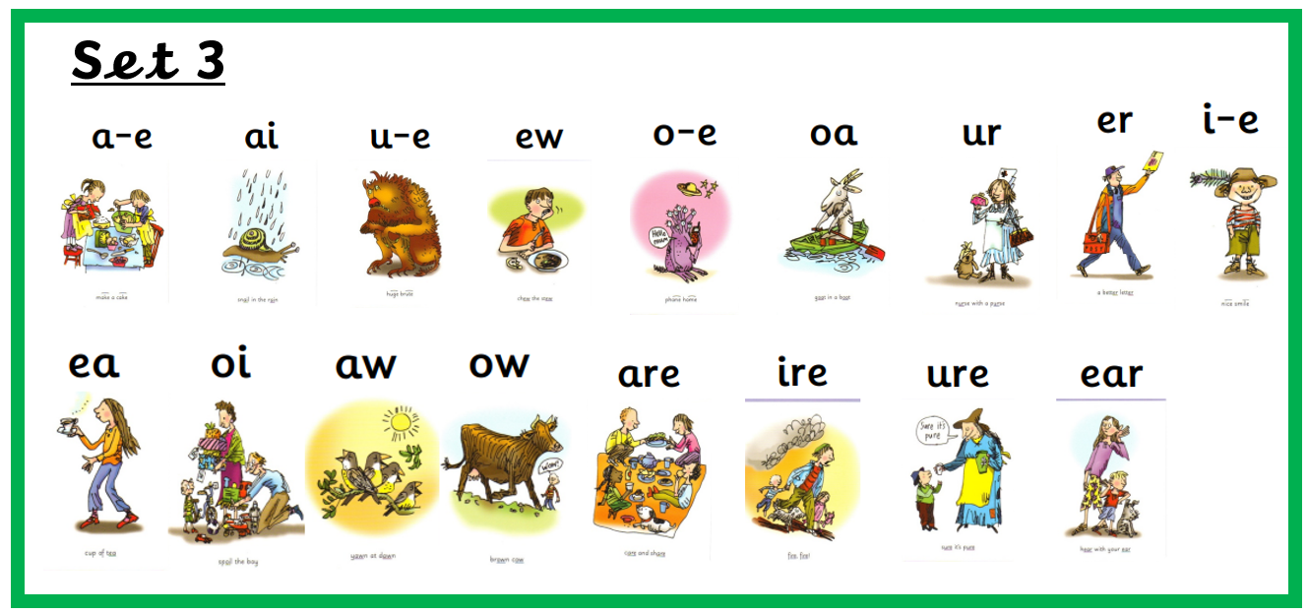
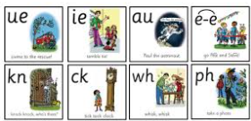
Set 2 and Set 3
Set 2 and Set 3 lessons follow a very similar structure. However, when children begin learning Set 3 sounds, they are encouraged to use letter names as well as the sounds.
Both sets include a mnemonic, a short, memorable rhyming phrase, to help children remember and retain each sound effectively.

Slide 8
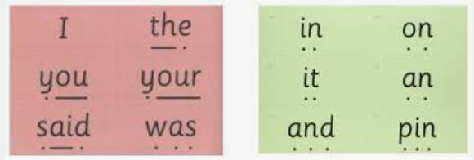
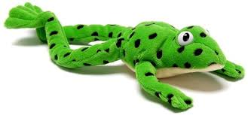
Read, Write, Inc. Terminology
Green words
Red words
Special friends
Fred talk
Fred in your head

Slide 9
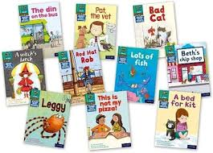
Developing fluency
The most effective way to develop a child’s fluency is through revisiting and rereading books and words. Children are encouraged to read each book at least three times before it is changed.
A suggested approach for reading at home:
Day 1 – Phonics Focus:
Take time to decode each word carefully.
Day 2 – Silent Reading & Sight Words:
Encourage your child to read “in their head” (Fred in your head). Use strategies such as my turn, your turn to support them.
Day 3 – Fluency & Expression:
Focus on reading smoothly with expression. Discuss the questions at the back of the book to develop comprehension.

Slide 10
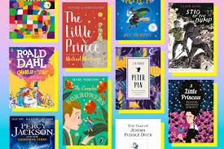
Reading and Vocabulary
Key Facts: Reading and the Vocabulary Gap
Children who are read to regularly hear far more words
By age 5, a child read to daily may hear almost 300,000 words from books.
A child rarely read to may hear fewer than 5,000 words from books.
Children who are regularly read to are more likely to:
Have larger vocabularies
Find it easier to learn to read
Have stronger understanding of texts
Do better across the curriculum

Slide 11
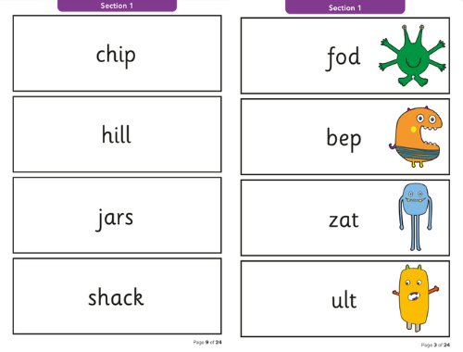
Phonics Screening Check
What is it?
The Phonics Screening Check is an assessment taken by all Year 1 children to check their understanding of phonics. It helps teachers see how well children can use their phonics knowledge to read words.
What does it involve?
Children read 40 words aloud, a mix of real words and “alien” (nonsense) words.
It usually takes about 5–10 minutes per child.

Slide 12
Thank you. Are there any questions?

