Slide 1
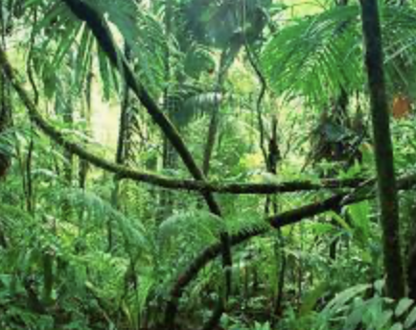

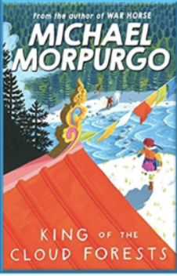


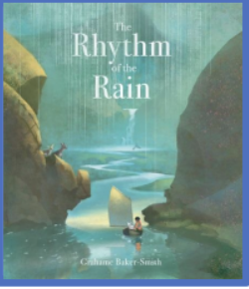
Summer Term 2025-26 - Curriculum bulletin
Year 3 & 4 – Under the Canopy
Mathematics
This term, year 3 will cover the topics of fractions, money, time, shape and statistics. For fractions, the children will learn to add and subtract fractions. They will learn how to find the fraction of an amount. For money, the children will learn to convert between £ and p. They will add and subtract amounts of money and solve problems to find change, For time, the children will learn to recognise Roman numerals to 12. They will learn to tell the time to the minute and how to read time on a digital clock. They will learn to use units of time such as hours, minutes and seconds and will solve problems in the context of time. For shape, the children will learn to recognise and compare turns and angles. They will measure and draw angles accurately using a protractor. They will learn to recognise and draw 2D shapes and describe them with the vocabulary horizonal, vertical, parallel and perpendicular. For statistics, the children will draw and interpret pictograms and bar charts. They will collect and represent data in two-way tables.
Year 4 will cover the topics of decimals, shape, statistics and position & direction. They will learn to make a whole with tenths and hundredths. They will learn to flexibly partition decimals. They will compare and order decimals and round them to the nearest whole number. For shape, the children will explore angles and symmetry in triangles and quadrilaterals. For statistics, they will learn to read, analyse and draw charts and line graphs. For position and direction, they will learn to describe position using co-ordinates. They will plot a 2D shape on a grid and describe a translation on a grid.
English
Reading:
As part of our ’Steps to Read’ programme the children will be reading a range of texts on the themes of stories, poetry and geography (rivers and mountains). The books will support the children to develop their word reading and comprehension skills as well as to increase their knowledge of a wider range of texts and themes.
Writing:
This term, year 3 and 4 children will be reading the book ‘Rhythm of the Rain’ by Graham Baker-Smith. The children will use the texts to write a narrative and an explanation text. They will be developing their use of inverted commas to punctuate direct speech as well as their knowledge of conjunctions, prepositions and adverbs to develop sentences. This term, the children will also be ‘Writing for Pleasure’ to write a narrative and an explanation text linked to their own ideas an interests.

Slide 2
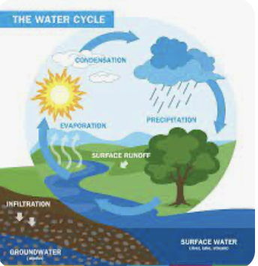
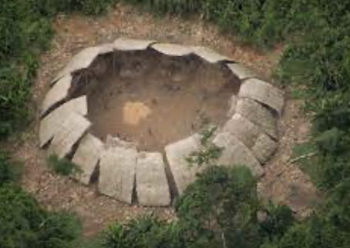

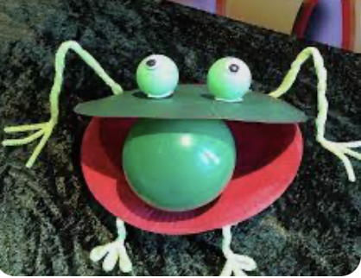
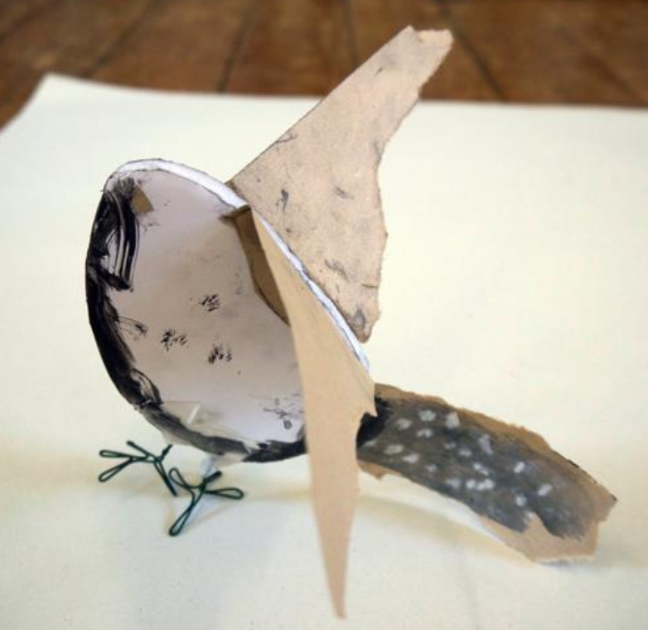
The Big Picture – Under the Canopy
Summer Term 2025-26 Curriculum bulletin
Geography – The Rainforest
History – Yanomami Tribe
For geography, the children will be learning about rainforests. They will locate rainforests around the world and learn the similarities and differences between tropical and temperate rainforests. They will learn to use geographical vocabulary to describe the features of rainforests, in particular, the Amazon rainforest. They will also be exploring the water cycle.
For history, the children will be learning about people native to the rainforest. They will understand that there are people living in rainforests who have never had contact with non-Indigenous people. They will learn about one tribe in particular, the Yanomami Tribe. They will explore significant events in the lives of the Yanomami tribe over the past 150 years, including their discovery, the impact of the gold rush on their home and the significant individual David Kopenawa who successfully campaigned for the rights of the Yanomami people to own their land by establishing the Yanomami park.
Science
For science, the children will be learning about states of matter. They will explore the properties of solids, liquids and gases and investigate materials as they change from one state to the other. This learning will be linked to the geography learning of the water cycle.
Design and Technology – Pneumatic jungle animal
For D&T, the children will be exploring pneumatics. They will demonstrate how to assemble the systems using syringes, tubing, balloons and plastic bottles. They will learn ways in which pneumatic systems can be used to operate levers. The children will demonstrate the correct and accurate use of measuring, marking out, cutting, joining and finishing skills and techniques to make a pneumatic rainforest creature.
Art - Birds
For art, the children will be exploring birds that live in the Amazon rainforest. They will practise drawing birds following close observation. They will use viewfinders to explore textures and features of birds. The children will explore how they can manipulate their drawings in an intuitive way to make 3d forms.

Slide 3

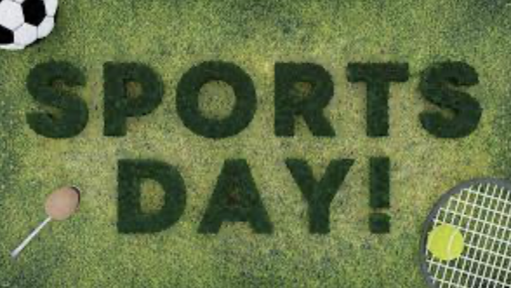
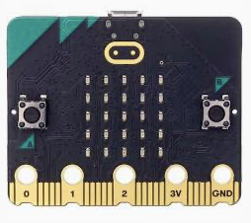

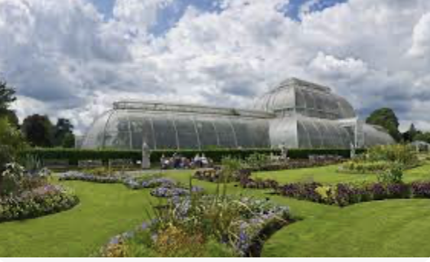
Summer Term 2025-26 - Curriculum bulletin
Religious Education
Music
For RE this term, the children will continue their learning about Islam. They will explore the question: What is the Qur’an and why do so many Muslims try to learn it by heart?
For music this term, year 3 and 4 will be learning to play the recorder. They will listen to pieces of music being played by the recorder and will describe the sounds they can hear using musical terminology. They will learn about the different parts that make up the recorder and will learn to play the notes B,A G, C and D. The children will learn to sing and play a simple tune using the notes learnt.
Physical Education
For P.E. this term, the children will be practising skills across the sports of, tennis, cricket and dance.
The children will also be doing athletics, where they will practice running, jumping and throwing. They look forward to demonstrating their skills at the end of term during sports day.
PSHE
For PSHE this term, we will be exploring the topic of ‘Families and People who care for Me’
The children will develop their understanding of what characterises a healthy family including respect for parents. They will understand why people decide to get married and that they share vows to demonstrate this commitment.
Trips and enrichment – Kew Gardens
This term, year 3 and 4 will visit Kew Gardens. They will take part in an immersive experience called ‘Rainforest – People and Plants’ where they will be exploring the sights and smells of the rainforest plants located in Kew’s historic Palm House.
They will work scientifically in the rainforest challenge, observing, investigating and analysing rainforest products and artefacts, discussing the importance of the rainforest in their everyday lives and raising questions about the choices we make.
Computing
For computing, the children will explore data collection and analysis. They will learn how to code the micro: bits so that they can collect and store data on temperature and light. The children will collect data and analyse in Microsoft Excel. They will learn to create a graph in the programme.

