Slide 2



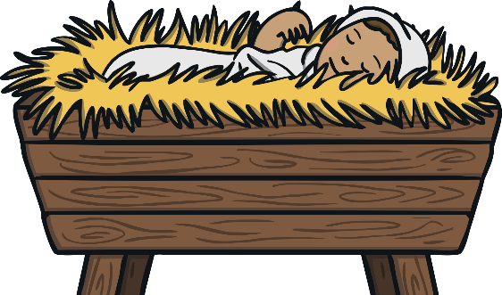
Silent night, holy night
All is calm, all is bright
Round yon Virgin mother and child
Holy infant so tender and mild

Slide 3
Sleep in heavenly peace
Sleep in heavenly peace

Slide 4
Silent night, holy night
Shepherds quake at the sight
Glories stream from heaven afar
Heavenly hosts singing alleluia

Slide 5
Christ, the saviour is born
Christ, the saviour is born

Slide 6
Silent night, holy night
Son of God, love’s pure light
Radiant beams from thy holy face
With the dawn of redeeming grace

Slide 7
Jesus, Lord, at thy birth
Jesus, Lord, at thy birth

