Slide 1
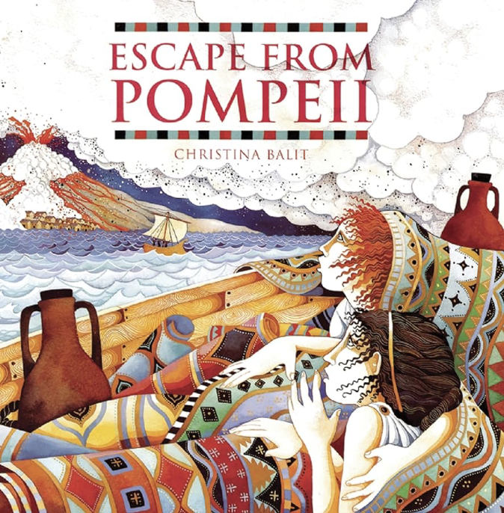
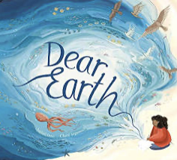
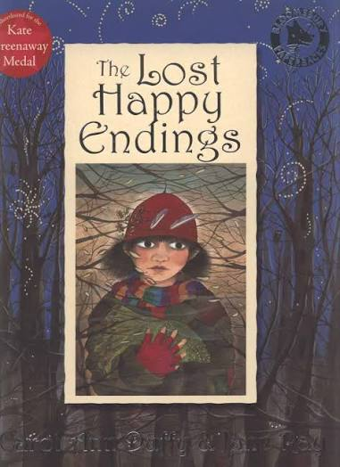
Autumn Term 2026 - Curriculum Bulletin
Year 3 & 4 – Beneath the Surface
Mathematics
English
For Mathematics this term, the children will be covering the topics of place value, addition, subtraction, multiplication and division.
In Year 3, the children will be learning to read, write and partition numbers to 1000. They will be able to say what is 1, 10, 100 and 1000 more or less than any given number to 1000. They will learn to round numbers to the nearest 10, 100 or 1000. They will be learning to add a two-digit number to a three-digit number using formal written methods. For multiplication and division, the children will be focusing on the 2,3,4 and 8 times tables and their associated division facts.
In Year 4, the children will be learning to read, write and partition numbers to 10,000. They will be able to say what is 1, 10, 100 and 1000 more or less than any given number to 10,000. They will learn to round numbers to the nearest 10, 100 or 1000. They will also learn that, in roman numerals, L represents 50 and C represents 100. They will be learning to add and subtract two four-digit numbers using formal written methods. For multiplication and division, the children will be focusing on the 6,7,9,11 and 12 times tables and their associated division facts. The children will be calculating the area of a shape by counting squares.
Reading:
For reading, the children will read the book ‘Escape from Pompeii’ by Christina Balit. They will also be taking part in our Reading Explorers scheme. They will discuss a range of themes and conventions through these texts. The children will be drawing inferences such as characters' feelings and motives as well as discussing words and phrases that capture the reader’s interest and imagination.
Writing:
As part of our writing programme, the children will be reading the books ‘Dear Earth’ by Isabel Otter and Clara Anganuzzi and ‘The Lost Happy Endings’ by Carol Ann Duffy. They will use the texts to plan and write a twisted narrative and an information letter. They will be learning how organise paragraphs around a theme and how to use apostrophes to indicate possession of singular and plural nouns. They will also learn to correctly punctuate speech using inverted commas.
The children will also have the opportunity to write for pleasure to create an information letter and a fairytale.

Slide 2
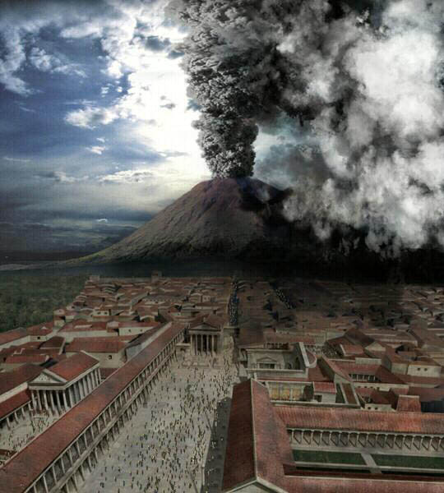
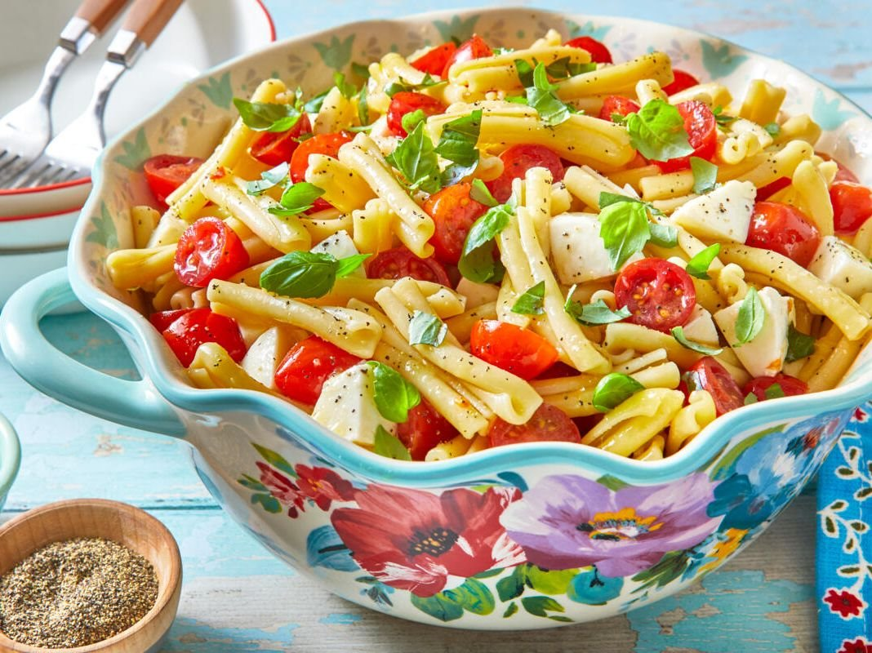
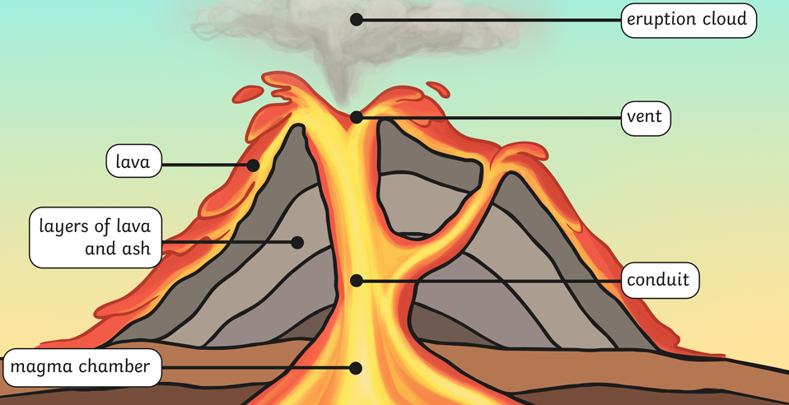
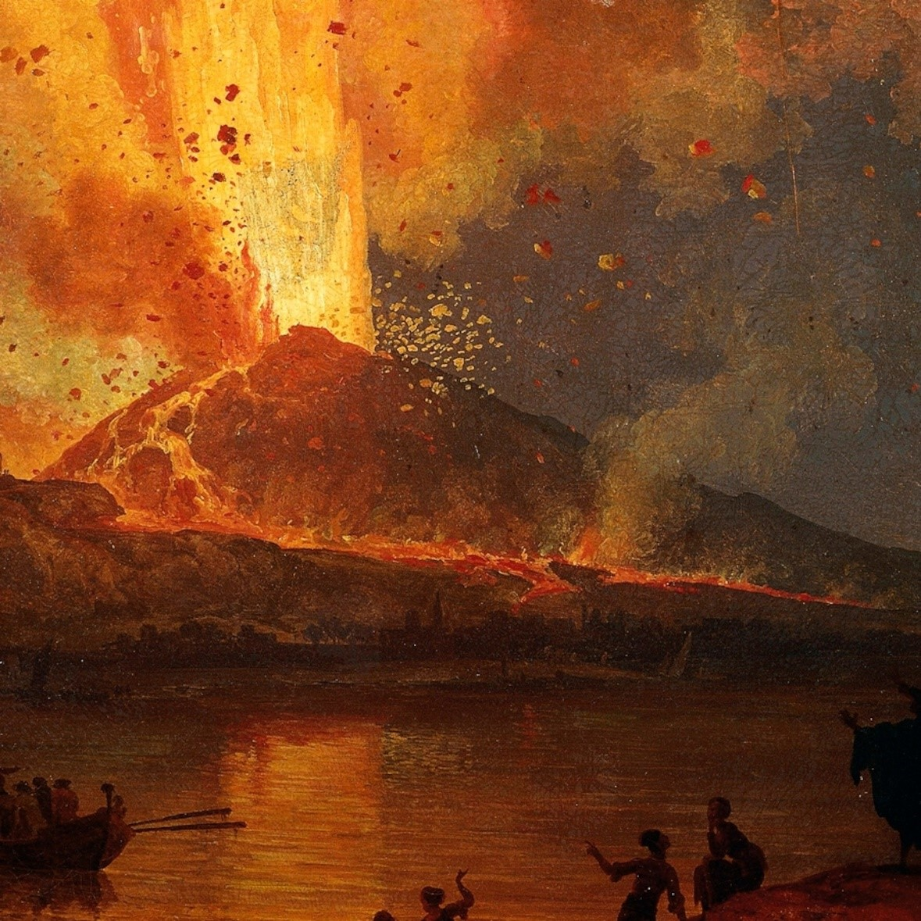
The Big Picture – Beneath the Surface
Autumn Term 2026 - Curriculum Bulletin
History – Pompeii and the Romans
Design and Technology – Italian Salad
For History, the children will be learning about the destruction of Pompeii in 79CE due to the eruption of Mount Vesuvius.
They will plot the events of the eruption on a timeline and will explore that can be learnt about the Roman way of life from the well-preserved ruins. The children will also learn about the the Roman Invasion of Britain and the impact that the Romans had on Britain such as roads, aqueducts, and writing system.
For Design and Technology, the children will be looking at the features of Italian food including the kids of vegetables grown and used there.
They will explore existing cooked salads and use their research to design and make a healthy Italian cooked salad.
The children will also learn about the importance of safety and hygiene practices when cooking and preparing food.
Art – Gestural drawings using charcoal
Geography – Volcanoes and Earthquakes
For Art, the children will be exploring the medium of charcoal. They will experiment with making different marks and textures using charcoal.
They will explore the work of artists Laura McKendry and Edgar Degas and how they have used charcoal to make imaginative and expressive artworks. The children will finish the unit by creating artwork that depicts the eruption of Pompeii.
For Geography, the children will learn about the volcanoes and earthquakes. They will learn about how volcanoes are formed and about the different layers of the Earth.
The children will look at the location of volcanoes in relation to the Earth’s tectonic plates.

Slide 3
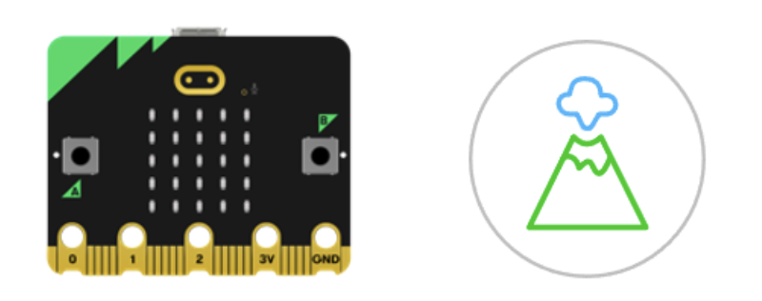
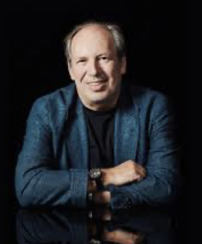
Autumn Term 2026 - Curriculum Bulletin
Computing
Music
In Computing, the children will experience a mixture of fun unplugged and programming activities related to animations. They will develop their understanding of decomposition, flowchart algorithms and repetition. They will then write, program and test an animation showing a volcanic eruption using the LEDs on the BBC micro:bit.
For Music, the children will be composing a soundscape piece to show the different stages of a volcanic eruption.
They will research soundscapes by the composer Hans Zimmer and listen to the features of his music. The children will think about what dynamics and rhythm they should use for the different stages of a volcanic eruption. They will explore terminology such as crescendo and decrescendo.
Physical Education
For P.E. this term, the children will be practicing skills across the sports of football, basketball and gymnastics. They will practice and develop key skills for each sport, including passing, moving, marking and shooting. The children will also develop attacking and defending principles while gaining a greater understanding of the tactical side through game related practice.
RE
For RE this term, the children will be exploring the questions: ‘Does prayer make a difference and how do Christians know?’ and ‘What is the Trinity?’.
They will learn that Christians believe God is Trinity: Father, Son and Holy Spirit and that Christians believe that Jesus is the Son of God and reveals to us what God the Father is like. They will also learn that Christians believe the Holy Spirit is God’s power at work in the world and in their lives today, enabling them to follow Jesus.
They will find out about how Christians pray, including special prayers such as the Lord’s prayer. They will explore how prayer changes things for a Christian.
PSHE
For PSHE this term, the children will be learning about Keeping Safe. They will learn about the different kinds of contact, including unwanted constant, which could also be bullying.
They will learn about the importance of seeking help from a trusted adult if they find physical; or emotional contact uncomfortable, or if they feel unsafe about anything.
They will also be working on identifying and naming different emotions.

Slide 4
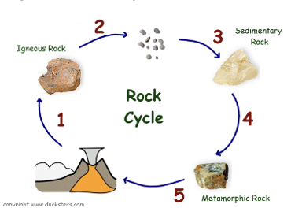
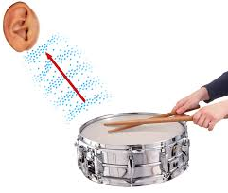
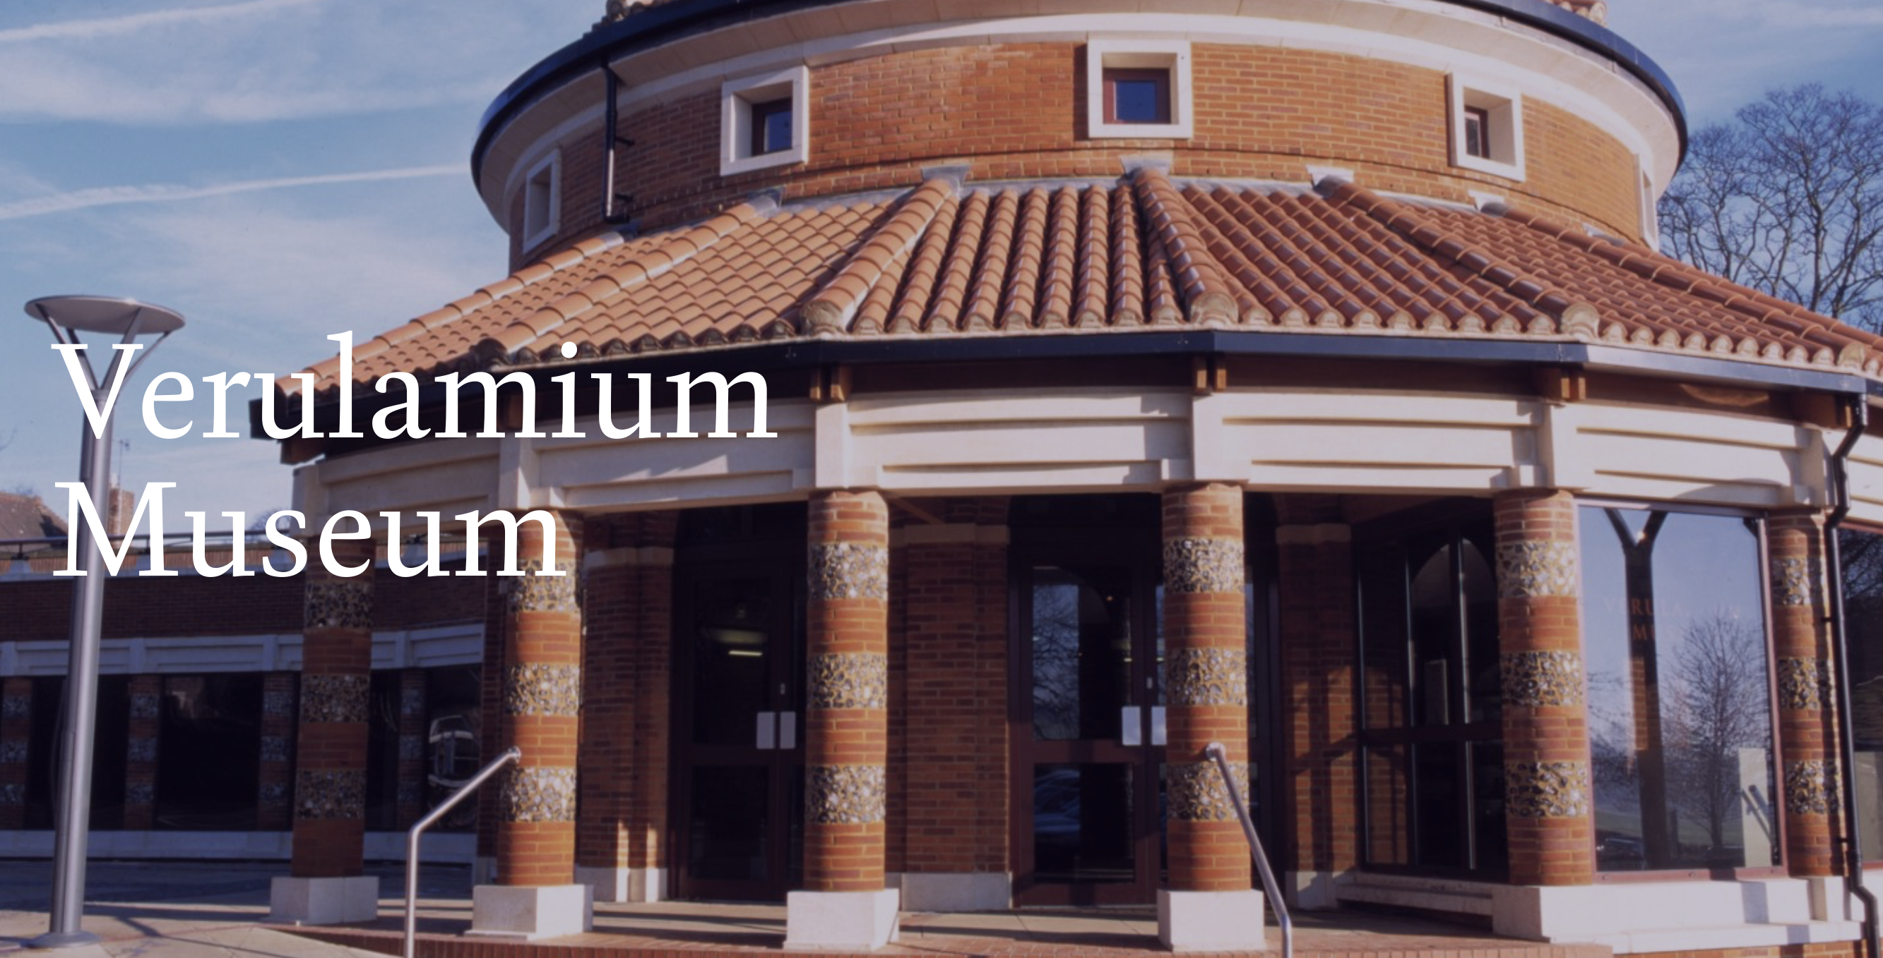
Autumn Term 2026 - Curriculum Bulletin
Science
For Science this term, the children will begin by exploring the topic of rocks and soils.
They will compare and group together different kinds of rocks based on their appearance and simple physical properties. They will learn how sedimentary, metamorphic and igneous rocks are formed. They will describe how fossils are formed and recognise that soils are made from rocks and organic matter.
The children will test the permeability of different soils to find out which type of soil offers the best drainage.
In the second half of term, the children will explore the topic of sound. They will learn that sounds are made by something vibrating. They will recognise that vibrations from sounds travel through a medium to the ear. They will experiment by finding patterns between the pitch and volume of a sound and features of the object that produce it. They will also explore how sounds get fainter as the distance from the sound source increases.
Trips and enrichment
This term, we will be taking year 3 & 4 to the Verulamium Museum in St. Albans where they will take part in a market workshop. During the interactive workshop the children will dress up as the Romans of Verulamium, and be tasked with investigating the market and finding the Roman objects on their shopping lists. Students will handle replica items that reflect the artefacts discovered during excavations at Verulamium and will be an exciting way for the children to increase and develop their knowledge of Roman daily life. They will have some time to explore the rest of the museum and local excavations.

